Slide 1
Code Generation
Prabhas Chongstitvatana
Department of Computer Engineering
Chulalongkorn University
Thailand

Slide 2
Approach
Beginning with Parse Tree
Abstract Interpretation
Interpreter (take a parse tree and "run" it)
Machine Abstraction
Machine Instructions (what kind of machine to "run" the abstract program)
Code Generation

Slide 3
Parse Tree
data structure: list
consists of operator and operand* Operator binary, unary, n-ary, function call Operand constant, local variable, global variable (include vector)

Slide 4
Illustrative example
Source language: a = b + c
=
/ \
a +
/ \
b c
Printed parsed tree: (= a (+ b c ))

Slide 5
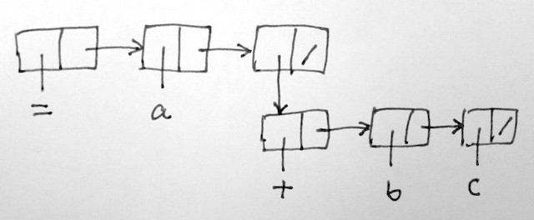
Data structure
This data structure is built from a number of cells.
A cell contains two fields, head and tail.
There are two types of cell: atom and dot-pair.
An atom is the end of a branch (a kind of leaf node).
A dot-pair is a pointer to another list.

Slide 6
a program to copy a parse tree
copy(a)
if(isatom(a)) return newatom(copyof(a))
else return cons(copy(head(a)),copy(tail(a)))

Slide 7
Interpreter
traverse a parse tree and execute the operator.
eval(e)
if (e == nil) stop
if isatom(e) do_atom(e)
// then e is a list (operator operand*)
a = head(e)
b = tail(e)
switch typeof(a)
PLUS: ret eval(arg1(b)) + eval(arg2(b))
MINUS:
...
IF: if( eval(arg1(b)) )
ret eval(arg2(b))
ret nil
...

Slide 8
Interpreter (2)
do_atom(a)
switch typeof(a)
NUM:
GLOBAL:
LOCAL:
...

Slide 9
Machine Instructions (S-code)
A stack-based instruction set.
S-code is zero-address instruction. The main working storage is a stack and is comparable to the registers in a processor.
A stack has two operations: push and pop.
It is not necessary to "address" the stack (hence the name "zero-address").

Slide 10
S-code
stack-based, fix 32-bit width
instruction format: argument:24-bit opcode:8-bit
arith: add, sub, mul, div, mod
logic: band, bor, bxor, shl, shr, not,
eq, ne, lt, le, gt, ge
data: ld, st, ldx, stx, lit, get, put
control: call, ret, case, fun, jt, jf, jmp
other: inc, dec, callt, sys
36 instructions

Slide 11
Example: local var a,b,c
source : a = b + c
S-code :
get.2
get.3
add
put.1

Slide 12
global var a,b,c
source: a = b + c
S-code:
ld.b
ld.c
add
st.a

Slide 13
control: local var a,b,c
source: if( a == b ) c = 1 else c = 2
S-code:
get.1
get.2
eq
jf xx
lit.1
put.3
jmp yy
:xx
lit.2
put.3
:yy

Slide 14
function call
source: mysum(a,b){ return a + b; }
S-code:
fun.x
get.1
get.2
add
ret.y

Slide 15
function call (2)
source: main(){ mysum(3,4); }
S-code:
fun.x
lit.3
lit.4
call.mysum
ret.y

Slide 16
Code Generator
The code generator works very much like an interpreter.
Instead of "run" the parse tree, it "generates" the machine code that will give the same result as "run".

Slide 17
eval(e)
if (e == nil) stop
if isatom(e) do_atom(e)
// then e is a list (operator operand*)
a = head(e)
b = tail(e)
switch(typeof(a))
PLUS:
eval(arg1(b))
eval(arg2(b))
out(ADD)
...
IF:
eval(arg1(b))
out(JF,0)
ads = CP-1
eval(arg2(b))
patch(ads,CP-ads)

Slide 18
Example: generate if statement
source: if (a == b) return b;
parse tree
(if (== #1 #2 ) (return #2 ))
machine code
get.1
get.2
eq
jf.L18
get.2
ret.3
:L18

Slide 19
Example of code generation
Source
sum(n, m){
if( n == m ) return m;
else return n + sum( n+1, m);
}
main(){
print(sum(1,10));
}
Parse Tree
(fun main
(print (call sum 1 10 )))
(fun sum
(if-else
(== #1 #2 )
(return #2 )
(return (+ #1 (call sum (+ #1 1 )#2 )))))

Slide 20
Machine code
Parse Tree
(fun main (print (call sum 1 10 )))
(fun sum
(if-else (== #1 #2 )
(return #2 )
(return (+ #1 (call sum (+ #1 1 )#2 )))))
:main
fun.1
lit.1
lit.10
call.sum
sys.1
ret.1
:sum
fun.1
get.2
get.1
eq
jf.L18
get.1
ret.3
jmp.L26
:L18
get.2
get.2
lit.1
add
get.1
call.sum
add
ret.3
:L26
ret.3

Slide 21
Summary
Begin with abstract interpretation of a parse tree
(interpreter)
then modify it to output "sequence of machine code"

